Slide 1
Flex

Slide 2
Why We Use Flexbox?
Provides a one‑dimensional layout system for rows or columns
Great for aligning items and distributing space automatically
Simplifies vertical and horizontal centering
Useful for responsive components such as navbars, cards, and forms
Helps designers create flexible layouts that adapt to different screen sizes

Slide 3
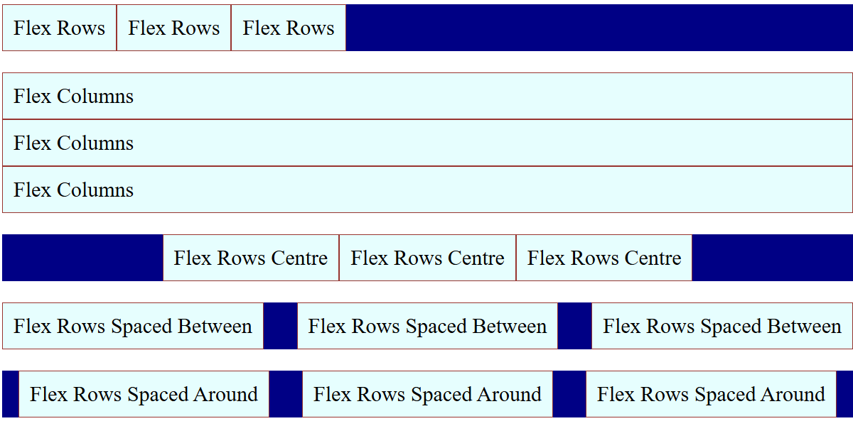
Using Flexbox - Introduction
Flexbox is a one-dimensional layout system for arranging items in rows or columns.
It helps with
alignment,
spacing, and
responsiveness.

Slide 4
Flexbox Basics
.container {
display: flex;
gap: 10px;
}
.item {
flex: 1; /* each item takes equal width */
background: #4CAF50;
text-align: center;
padding: 20px;
}
💡 Flex container with equal-width items.
How it works:
display: flex → turns container into a flexible layout
flex: 1 → items grow equally to fill available space
gap → adds consistent spacing between items
Why it matters:
Simplifies responsive layouts without floats or grids
Items automatically adjust width as container resizes
Foundation for many modern UI designs
View

Slide 5
Flex Container Properties
flex-direction: Sets layout direction — use row (horizontal) or column (vertical).
justify-content: Aligns items along the main axis — flex-start, center, or space-between.
align-items: Aligns items on the cross axis — stretch fills space, center aligns neatly.
.container {
display: flex;
flex-direction: row | column;
justify-content: flex-start | center | space-between;
align-items: stretch | center;
}
View

Slide 6
Flexbox Alignment
💡 Distribute items horizontally and centre vertically.
.container {
display: flex;
justify-content: space-between;
align-items: center;
}
View

Slide 7
Flex Item Properties
align-self: Overrides align-items for a single item — e.g., center, flex-start, stretch.
order: Controls item position — lower numbers appear first, default is 0.
.item {
flex: 1; /* grow */
align-self: center; /* overrides align-items */
order: 2; /* item position */
}
View

Slide 8

Example: Horizontal Navigation Bar
<style>
nav {
display: flex;
justify-content: space-around;
}
</style>
<nav>
<a>Home</a>
<a>About</a>
<a>Contact</a>
</nav>

Slide 9
Responsive Card Layout
flex-wrap: Allows items to wrap onto multiple lines instead of shrinking use wrap for responsiveness.
flex: 1 1 calc(33.33% - 20px)
1 → item can grow
1 → item can shrink
calc(33.33% - 20px) → base size (1/3 width minus gap)
.cards {
display: flex;
flex-wrap: wrap;
gap: 20px;
}
.card {
flex: 1 1 calc(33.33% - 20px);
min-width: 250px;
}
view

Slide 10
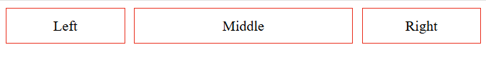
Setting proportional size
This example shows how to set double space for one element (flex:2)
Flex:1
10px
Flex:2
10px
Flex: 1
<body>
<div class="container">
<div class="item">Left</div>
<div class="item middle">Middle</div>
<div class="item">Right</div>
</div>
</body>
.container {
display: flex;
gap: 10px;
}
.item {
flex: 1;
}
.middle {
flex: 2;
}
view

Slide 11
Flex Wrap & Order
.container {
display: flex;
flex-wrap: wrap;
gap: 10px;
}
@media (max-width:600px) {
.item:nth-child(3) {
order: -1;
}
}
💡 Items wrap and reorder on small screens.
view

Slide 12
Progressive Enhancement
function enhance() {
if (window.innerWidth > 700) {
cards.style.display = 'flex'; cards.style.overflowX = 'auto';
}
else {
cards.style.display = 'block';
}
} window.addEventListener('resize', enhance);
enhance();
💡 Flex layout applied dynamically on larger screens.
How it works:
Switches layout between block and flex with horizontal scroll
Responds to window resize events in real time
Why it matters:
Allows custom behaviour beyond CSS-only solutions
Enhances UX for interactive or dynamic layouts
Complements responsive CSS techniques like @media and @container
View

Slide 13
Flex Tips
Use `flex-wrap: wrap` for responsiveness
Combine `gap` with `flex` for consistent spacing
Test flex behavior at different screen widths

Slide 14
Lab – Flex
Experiment with different flex attributes

